Slide 1
Living recommendation in ADELAIDE CBD

Slide 2
INTRODUCTION
This project aims to provide relevant existing data and conduct appropriate analysis to find similar neighbourhood between Melbourne CBD and Adelaide CBD based on their nearby venues.

Slide 3
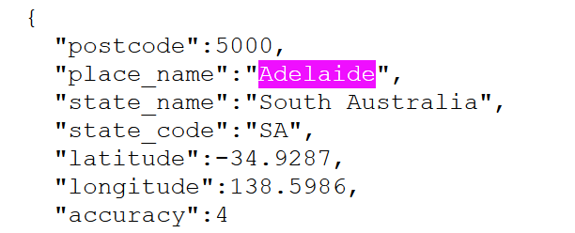
DATA ANALYSIS
Data Collection
Australia post codes, taken from https://raw.githubusercontent.com/Elkfox/Australian-Postcode-Data/master/au_postcodes.json
Four Square Data, taken from the provided API
Post codes data is in .json format, example below:

Slide 4
METHODOLOGY
For data cleaning, >10 km from CBD in each target state is filtered out. Merging two data sets, target Area by post code and Four-Square data by postcode.
Accessing Four Square API databases and limit Four Square to return max 100 venues within 500 metres radius
Find Top 5 most common venues in selected areas in Adelaide and Melbourne
Do clustering analysis.
First, determine proper number of clusters using elbow method
Applying k-means clustering, with k=3

Slide 5
METHODOLOGY
Result is three clusters below:

Slide 6
CONCLUSION
From the three clusters, cluster 3 does not have Adelaide post codes, which leave cluster 1 and cluster 2 to be the options left for someone wants to move from Melbourne to Adelaide. If someone used to live in variety of venues around, list of Adelaide (SA, South Australia) post codes in Cluster 1 can be preferred. If someone used to live only near the local restaurants and more café or coffee shop, cluster 2 can be preferred.

